Slide 1
SqueezeNet CNN Accelerator on Gem5-SALAM
ECE-752 Project
Balaji Adithya Venkataramana
Subhadip Kundu

Slide 2
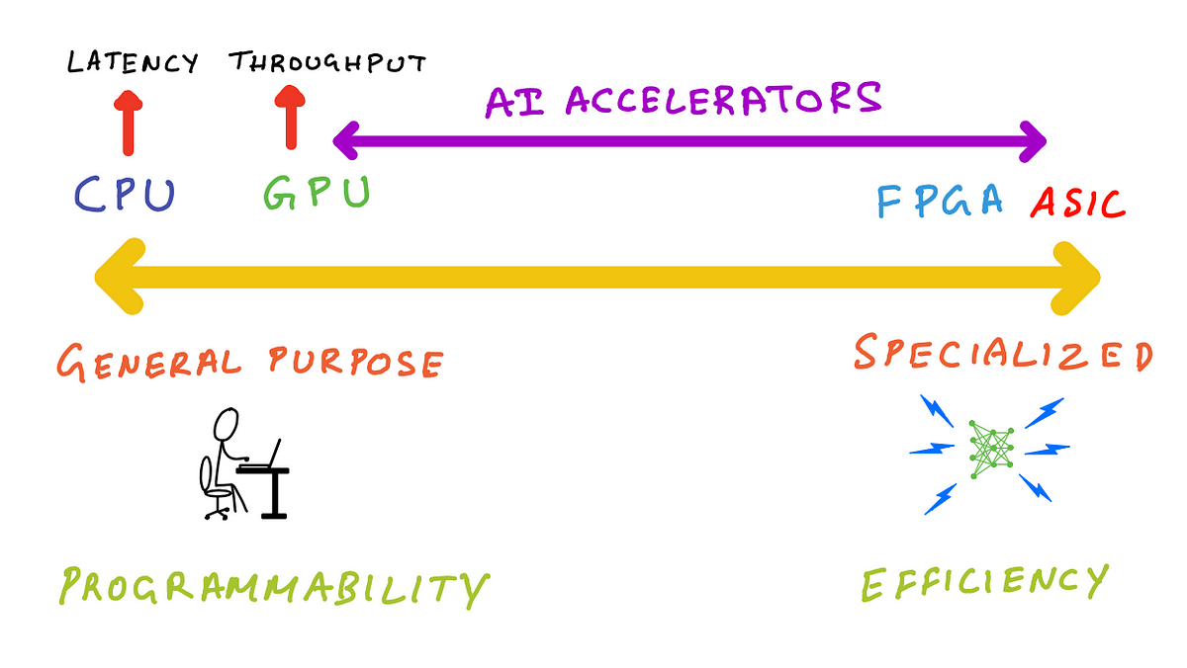
What is an accelerator?
Image source: https://towardsdatascience.com/ai-accelerators-machine-learning-algorithms-and-their-co-design-and-evolution-2676efd47179

Slide 3
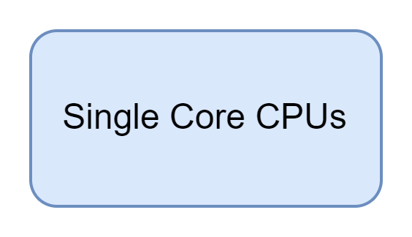
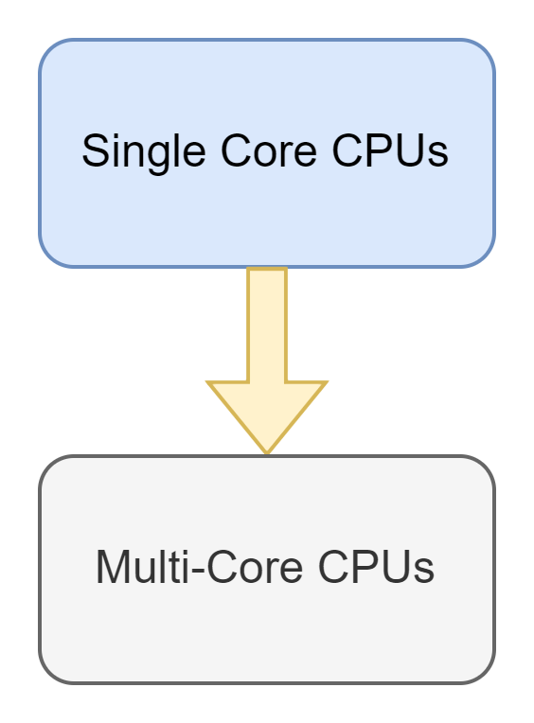
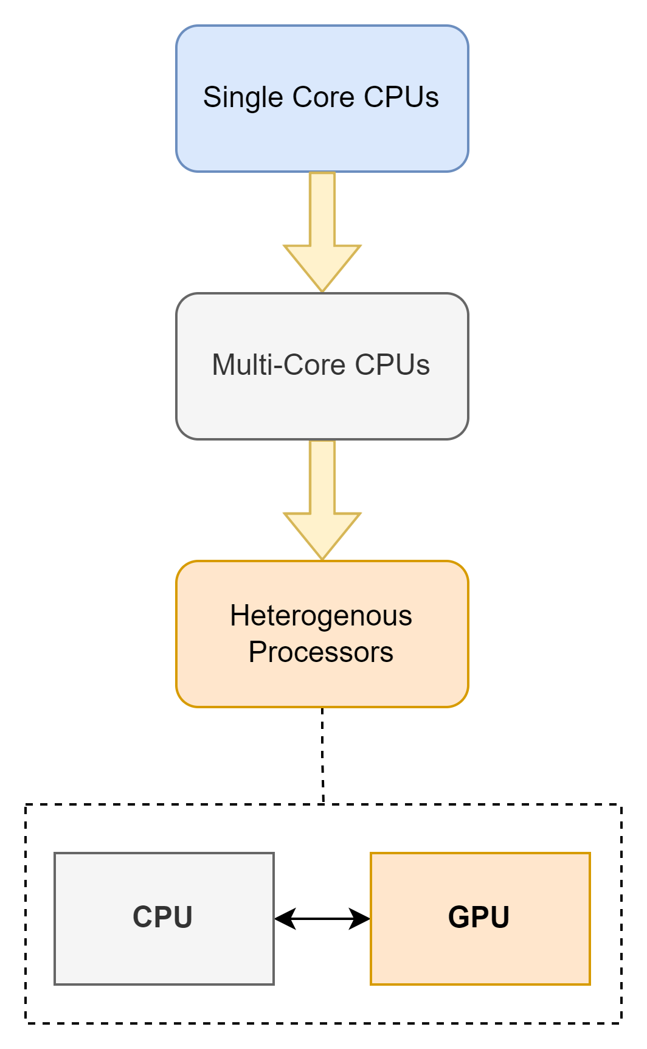
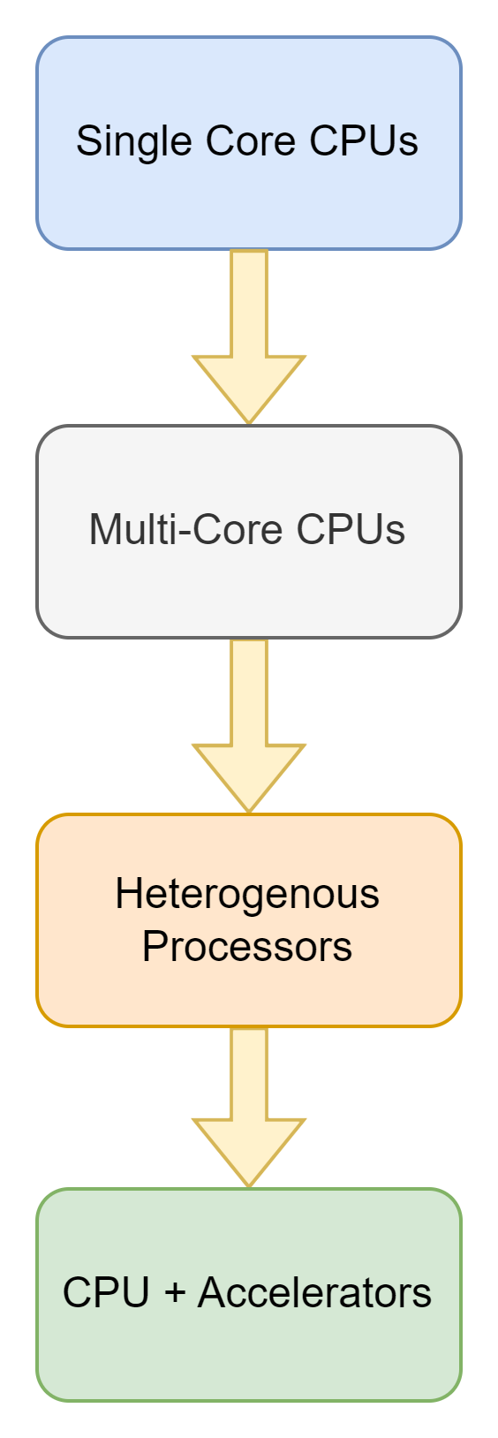
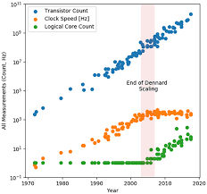

Why is there a need for accelerators?
Ever- increasing demand for Performance vs Power constraints
Dennard Scaling Ends
Need for more Performance

Slide 4
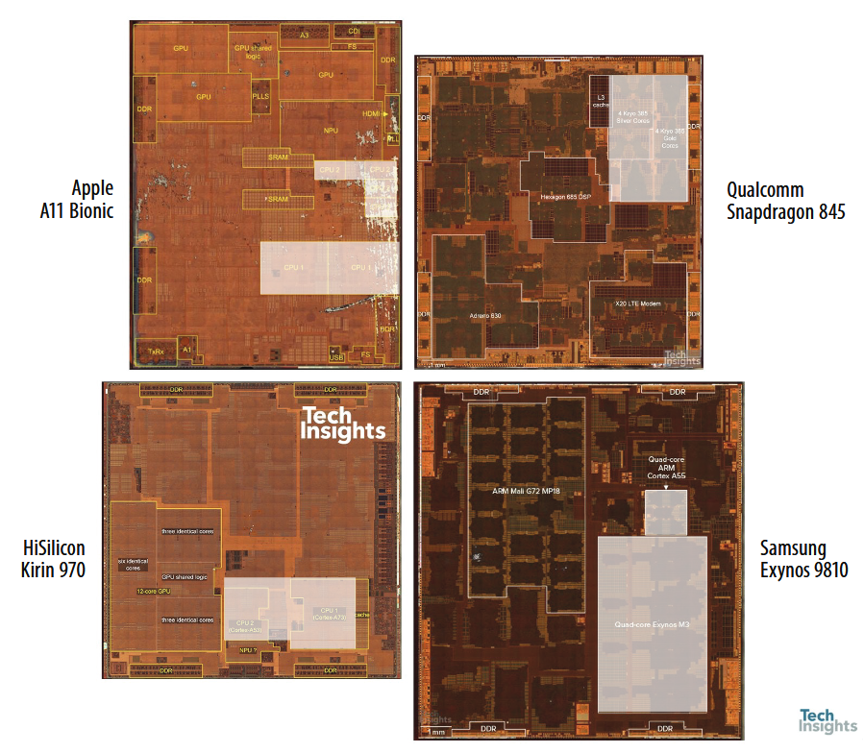
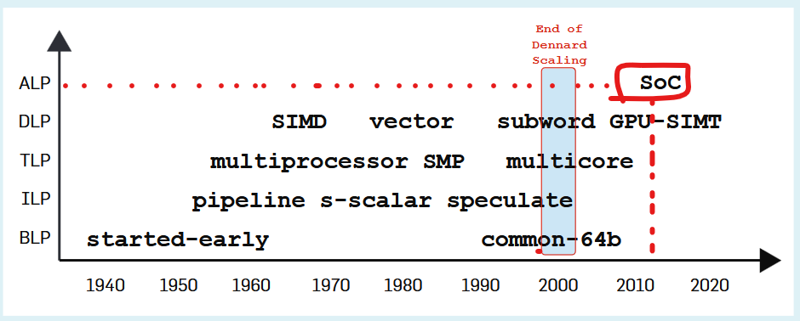
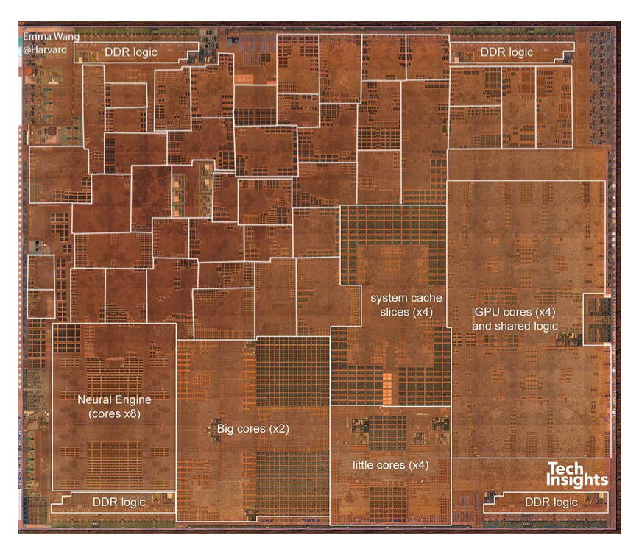

Growing Use of Accelerators in modern designs
Domain Specific Applications
DSPs
Image Processing
Image Source: M. D. Hill and V. J. Reddi, “Accelerator-Level Parallelism,” arXiv, vol. arXiv:1907.02064v4 [cs.DC], 2019
A12 Bionic Chip: All highlighted blocks – Accelerators

Slide 5
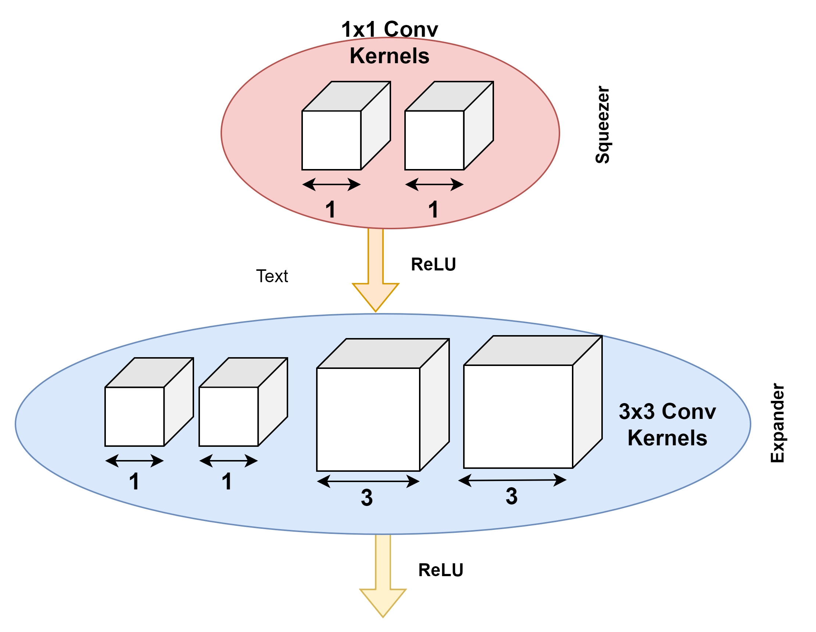
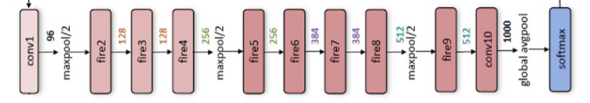
An Accelerator – based on SqueezeNet CNN
One Specific ML Application → Image Classification
SqueezeNet → Convolutional Neural Network (CNN)
Convolution functions → Highly Parallelizable
HEAD
BODY
TAIL
Image Source: | https://doi.org/10.48550/arXiv.1602.07360
Notes:
Chose one such specific application called Image Classification → frequently used in our phone’s camera app → Face recognition; Object classification
We picked a highly efficient model called SqueezeNet → which is Convolutional Neural Network
It contains multiple convolution functions → breaks down to MAC operations which can be parallelized.
Hence, we decided to model this CNN as an accelerator

Slide 6
Project Agenda
Design
System Level Overview of Accelerator Function
Data Movement options
Accelerator Clusters
SqueezeNet Accelerator Model Overview
Gem5-SALAM Simulation Flow
Evaluation
Future Work
QnA
Notes:
Bare-Metal + Full-System Mode
Future Wor

Slide 7
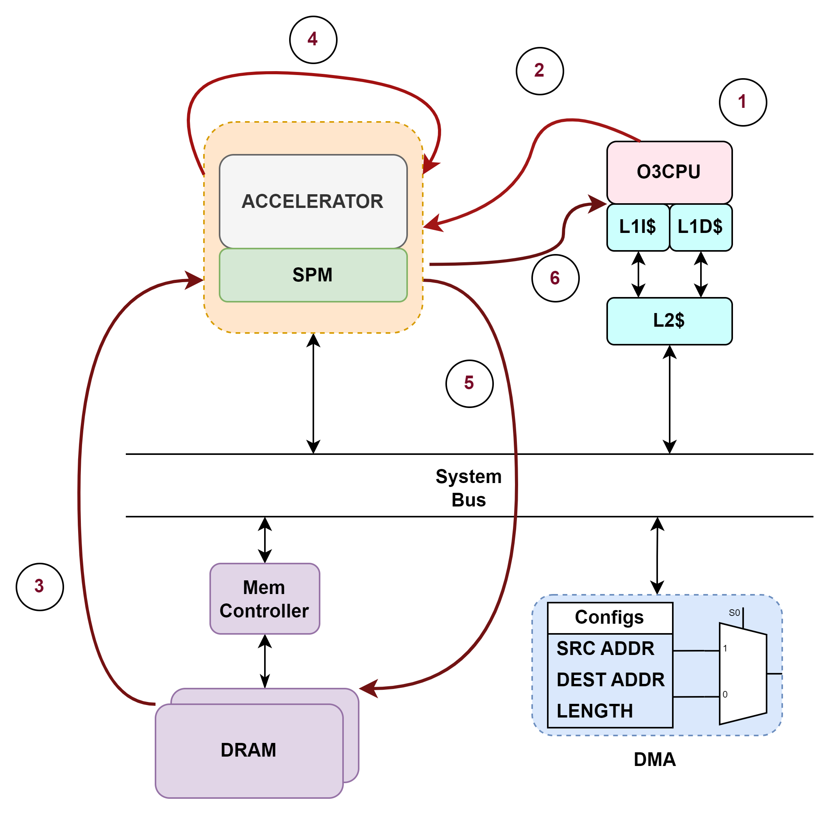
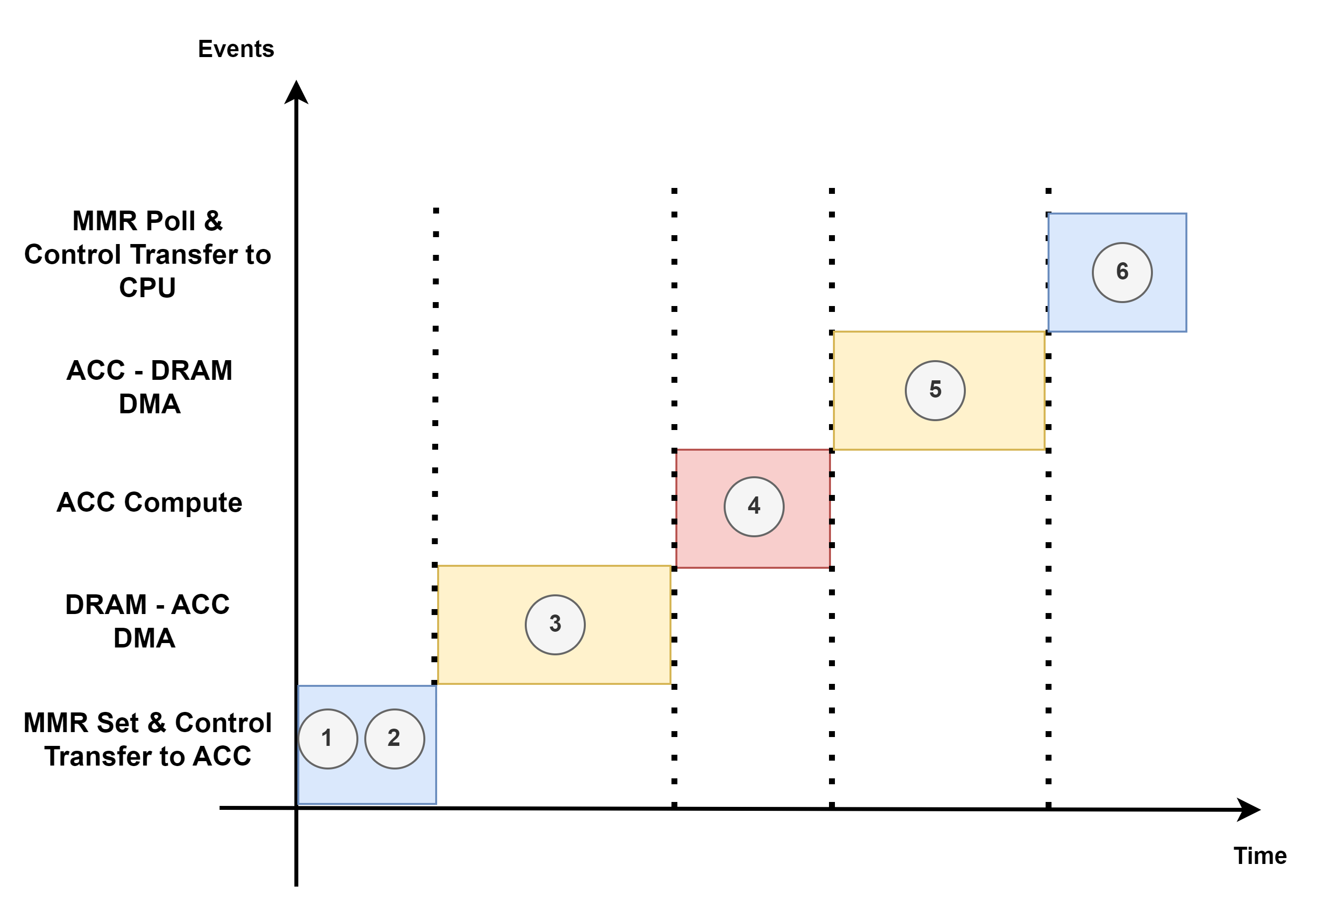
Accelerator System Level Overview
In an SoC, accelerator execution involves more than just computation.
Notes:
Set the MMR (Memory Mapped Registers) related to ACCELERATOR control
Transfer Control to the Accelerator
DMA Access to get data into Scratch Pad Memory
Accelerator Execution -> This is when the parallelized computation is done
Transfer data back to DRAM (via DMA Access)
Control Transferred back to O3CPU (MMR value updated and polled)
This can be extended to N number of accelerators in the system

Slide 8
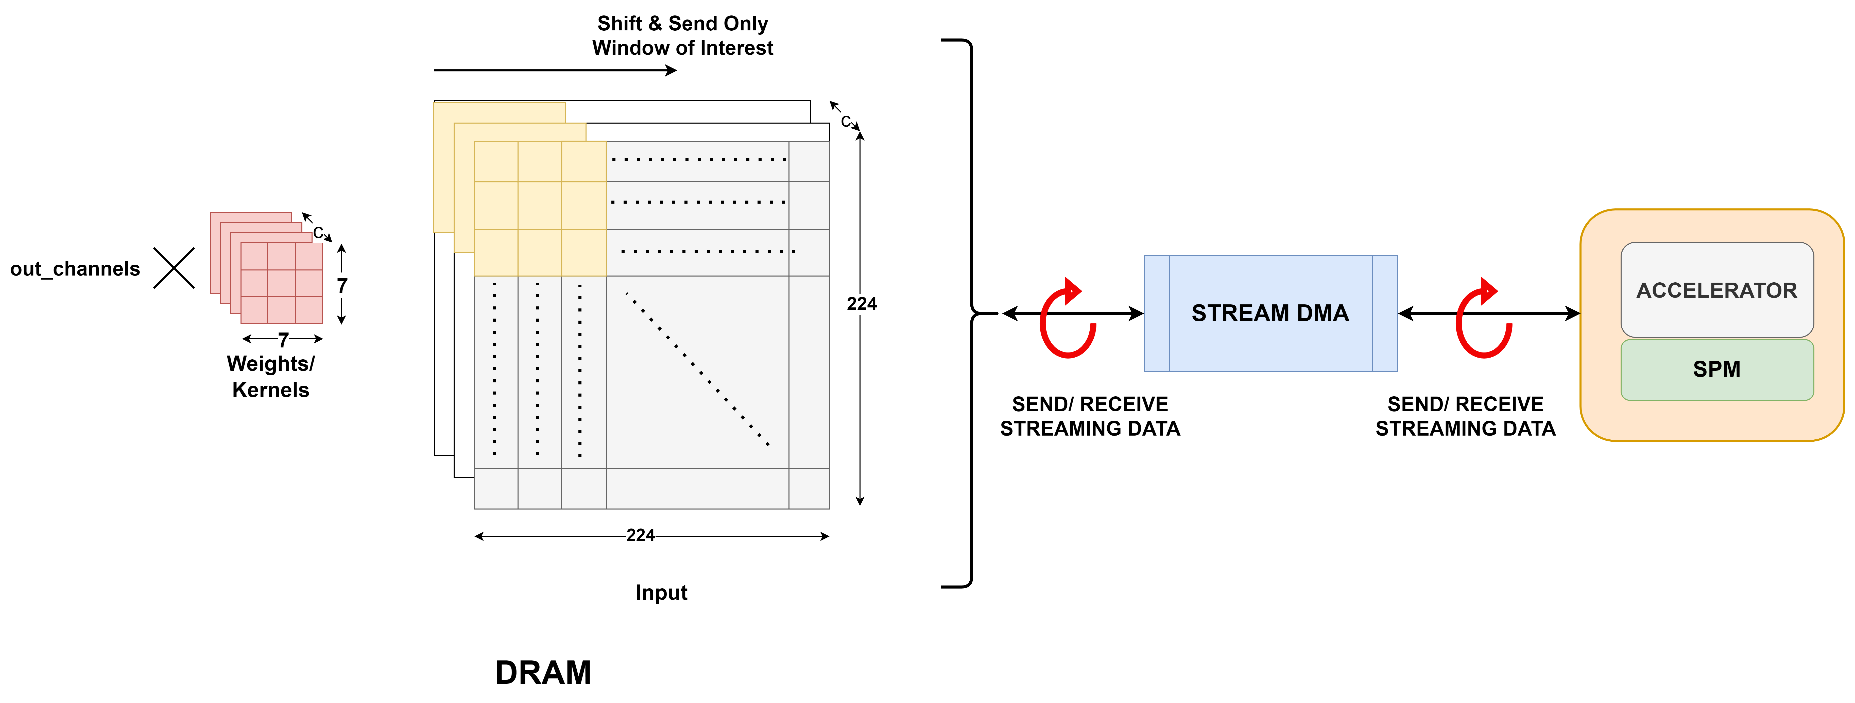
Data Movement Options – Streaming DMA
Not feasible to transfer Input data all at once
B’coz of it’s Massive Size.
Will bloat up the ScratchPad Memory size.
Instead transfer only the portion on which conv operation is done in a windowed manner via stream DMA.
Notes:
The inputs sizes are very huge and can’t be transferred completely to the Accelerator at once.

Slide 9
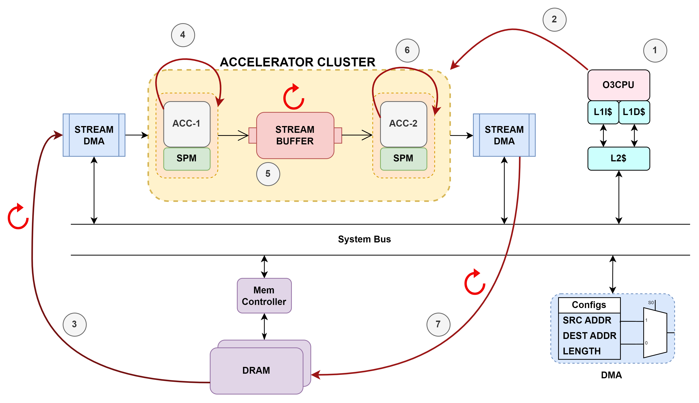
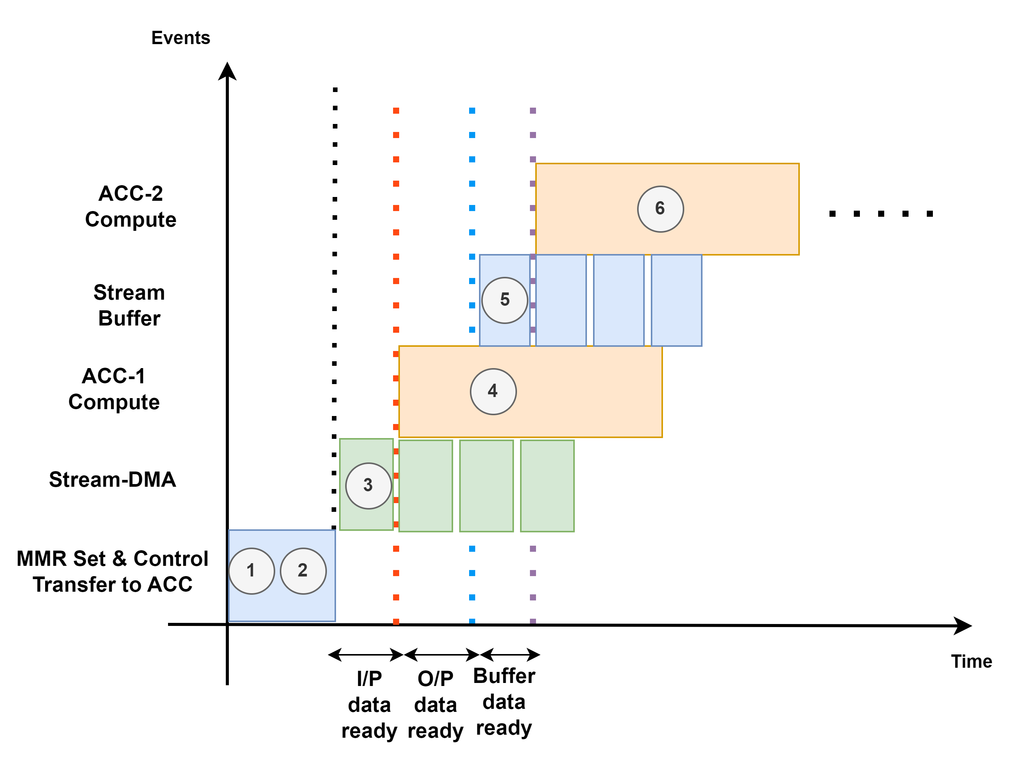
Accelerator Clusters
Sometimes, it is beneficial to split up a model into clusters.
Each cluster can have multiple accelerators.
This is done to simplify the organization of accelerator related resources. [such as Scratch-Pad Memory]

Slide 10
The SqueezeNet Accelerator
HEAD
BODY
TAIL
Head Accelerator Cluster
1x Convolution Acc
1x Maxpool Acc
Body Accelerator Cluster
9x Fire modules
Each with 3x Convolution Acc
2x Maxpool Acc
Tail Accelerator Cluster
1x Global Avgpool Acc
1x Softmax Acc
Image Source: | https://doi.org/10.48550/arXiv.1602.07360

Slide 11
Gem5-SALAM Simulator Flow
Gem5-SALAM works on LLVM compiler
The instructions in the LLVM-IR representation are mapped to supported functional Units in the Accelerator
For example, add & sub → mapped to Add Functional Unit
Multiplication → Would be mapped to Multiply Functional Unit
These Units are configurable in terms of:
Execution Time
Configurable opcode number
Limit count
Notes:
→ Add & Multiplication is used in Convolution Operation

Slide 12
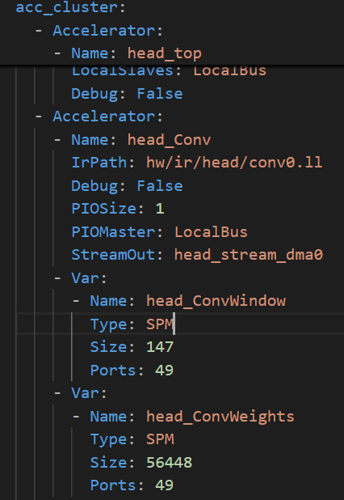
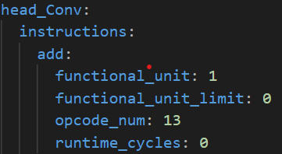
Evaluation: Accelerator configuration
Convolution accelerator Configuration:
Sys Config:
Hardware Config:

Slide 13
Evaluation: CPU and System Configuration
O3CPU:
DeriveO3CPU
We have kept all the configurations as default.
Memory and System:
running on bare metal mode.
Memory type: DDR4_2400_8x8
Memory size: 4 GB.
Image and Weight loaded from a default address location.

Slide 14
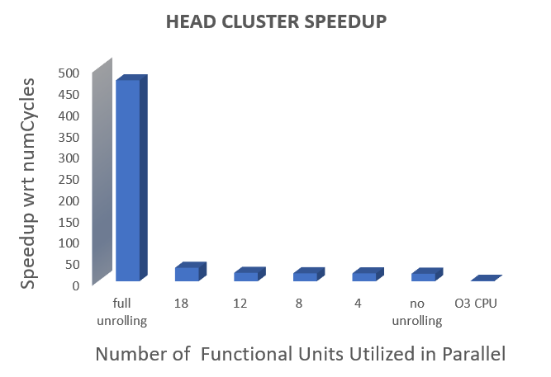
Evaluation results
Ran on the Head Cluster accelerator with loop unrolling.
Accelerator Inputs/Outputs Configs:
Image size 224x224
Kernel Size 7x7
Output channel 96

Slide 15
Future Work
Try & Complete other clusters
Which has series of convolution and max pools (Fire modules).
The ultimate goal is to simulate the full model (i.e. SoftMax layer at the last).
Try & optimize the Convolution accelerator model so the SPM usage is less.
Adding Cluster Cache to the Accelerator Cluster and view the change in performance (in terms of numCycles).
Optimal number of functional units
Finding the optimal point beyond which there is no gain in adding more FUs to the accelerator.

Slide 16

Questions?

Slide 17
Backup-1: Transfer of Control from Host to Device
The control Transfer from the (host – O3CPU) to (device - accelerator) is done based on setting Memory Mapped registers [that are polled using an ISR constantly to mark execution completion]
MMR for start: DEV_INIT = 0x0
MMR for stop: DEV_INTR = 0x4

Slide 18
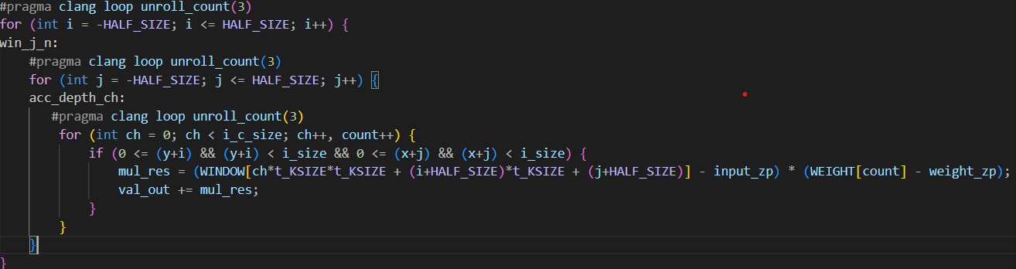
Backup-2: Loop Unrolling -> Functional Unit Mapping
To perform loop unrolling -> we make use of the pragma directives from the CLANG compiler
The hardware is derived form data-flow graph generated from the LLVM-IR.
The unrolling creates (N) way parallelism [3-way in the above case for each loop & 27x in total]

